Slide 1



Slide 2

Dr. Smart: Digital Diagnostician
Supervised by:
Sir. Rehan Tariq
Group Members:
Muhammad Sohaib Tahir (FA17-BCS-067)
Daniyal Ahmed (FA17-BCS-062)
Department of Computer Science
COMSATS University Islamabad, Attock Campus

Slide 3
Outline
Project Abstract
Introduction
Problem statement
Motivation and Scope
Related work Comparison
System Architecture and Features
Goals and Objectives
Individual Tasks
Gantt Chart
Tools and Technologies
Work Update

Slide 4

Project Abstract
“Shoot At Sight” is basically a server-based 3D Multiplayer Shooting Game. Unlike traditional style of shooting games like PUBG and COD this game involves a totally different kind of scenario that makes the game more interesting. This game involves two teams that fight with each other to gain maximum number of points but killing other players is not easy at all due to their special abilities.
Traditionally both teams have human characters that fight with each other to win a game but in this game one team say Team A will consist of human characters and the other team say Team B will have the ability to turn their characters into any other object like table, chair, bullet, cart or anything that is available on the scene and they think it may be beneficial for hiding for a longer time.
_______________________________

Slide 5
Cont..
Team A purpose is to find the hidden players of Team B by using their special abilities on the other hand Team B purpose is to hide themselves as long as possible to gain the maximum number of points. At the end the team that have maximum number of points will be declared winner.
If we have no online player and we want to play the game, the enemies will fight on the bases of Artificial Intelligence, and the enemy will be capable to beat us. The concept of the game is totally different, the users will definitely like the game.

Slide 6
Introduction
Initially there will be a timer whenever we start the game. Then Team B will have some time for hiding themselves in a map. Both teams have 6 players with the following abilities.
Team (A) Abilities:
First character has the ability to revive other players.
Second character has 2 lives.
Third character has unlimited ammo.
Fourth character has the ability to run fast.
Fifth character has the better weapon than others.
Sixth character has bigger life bar.

Slide 7
Cont..
Team (B) Abilities:
Each character has a pistol.
Each character has a flash bang.
Can turn into any other object present in the scene.
After Team B hides, the game will start. Team B will try its best to hide themselves from Team A by turning themselves into the objects that can be least doubtful. Each hidden player of Team B will make 4 whistles during the gameplay in order to balance the gameplay between the two teams.

Slide 8
Cont..
Then Team A will start to search for the hidden Team B players. It’s up to Team A that how they will use their special abilities strategically to eliminate Team B players. For example, if they doubt that there might some enemy players then the character with bigger life bar should lead the team for safety. Similarly, in the other half those abilities will get interchanged and total points will be calculated.
Team B characters will get more points if they convert themselves into bigger objects for hiding or by killing Team A players. Team B players will get more points if they hide themselves for a longer period of time. Team A characters will get points whenever they hit the hidden players of Team B or by killing Team B players.

Slide 9
Problem Statement
Computer games are been created since 1990's. Right around 33% of the total population plays computer games. A large portion of them are fan of multiplayer games. From most recent 15 years same sort of multiplayer games are being created by various studios. Even though they are engaging, however rehashing a similar idea at some point causes the client to feel exhausted. Our project would give answers to the following questions:
How do we bring innovation in gaming development ideas?
How much the word effectiveness is important to this field?
What are those factors that make a game interesting?

Slide 10
Motivation and Scope
The project is to learn the working of shooting games like PUBG, and to understand how Artificial Intelligence (AI) works in game development. Additionally, the purpose of the project is to provide the society a game where they will enjoy having the combat with the opponent players in a more interesting and innovative way. We are hopeful that all these attributes are going to enhance our learning and skills towards the professional game development.

Slide 11
Related Work Comparison
Games/Features | Multiplayer | 3D | Team Communication | Character Abilities | TPP/FPP Gameplay | AI Bots | Realistic Graphics
Prop hunt Portable | ✔ | ✔ | ✖ | ✖ | ✖ | ✖ | ✖
H.I.D.E | ✔ | ✔ | ✖ | ✖ | ✖ | ✖ | ✖
Prop Hunt Mobile | ✔ | ✖ | ✖ | ✖ | ✖ | ✖ | ✖
Hide Online | ✔ | ✔ | ✖ | ✖ | ✖ | ✖ | ✖
Shoot At Sight(OUR) | ✔ | ✔v | ✔ | ✔ | ✔ | ✔ | ✔
_______________________________

Slide 12
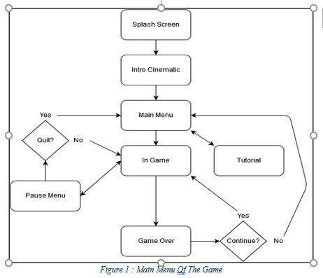
System Architecture and Features
_______________________________

Slide 13
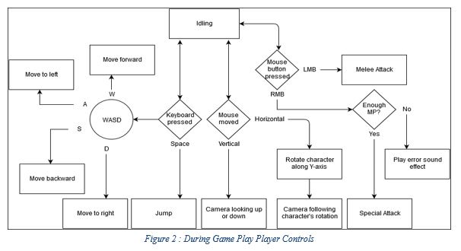
Cont..

Slide 14
Goals and Objectives
We will introduce some of these features in this game, which are enlisted below.
Multiplayer gaming.
Both TPP and FPP modes.
Realistic graphics.
Team communication.
In Team A each player will have different qualities & special abilities.
In Team B each player will have ability to transform themselves into other objects.
Enemy will fight on the base of artificial intelligence, in case of no online player.
_______________________________

Slide 15
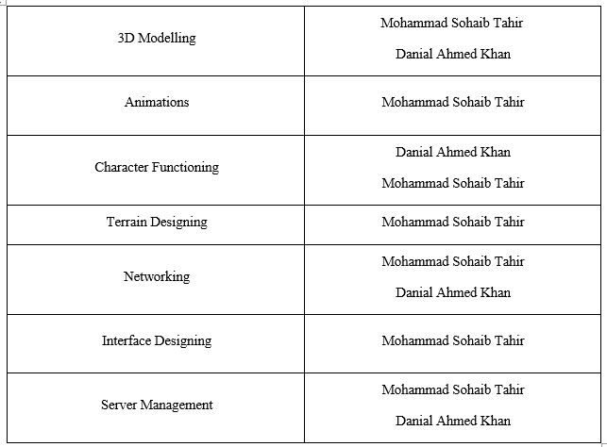
Individual Tasks
_______________________________

Slide 16
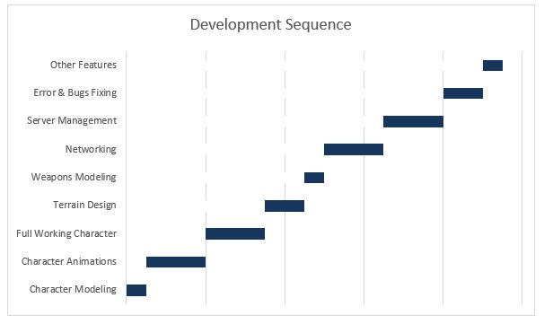
Gantt Chart

Slide 17
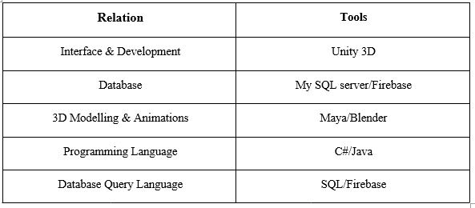
Tools and Technologies
_______________________________

Slide 18
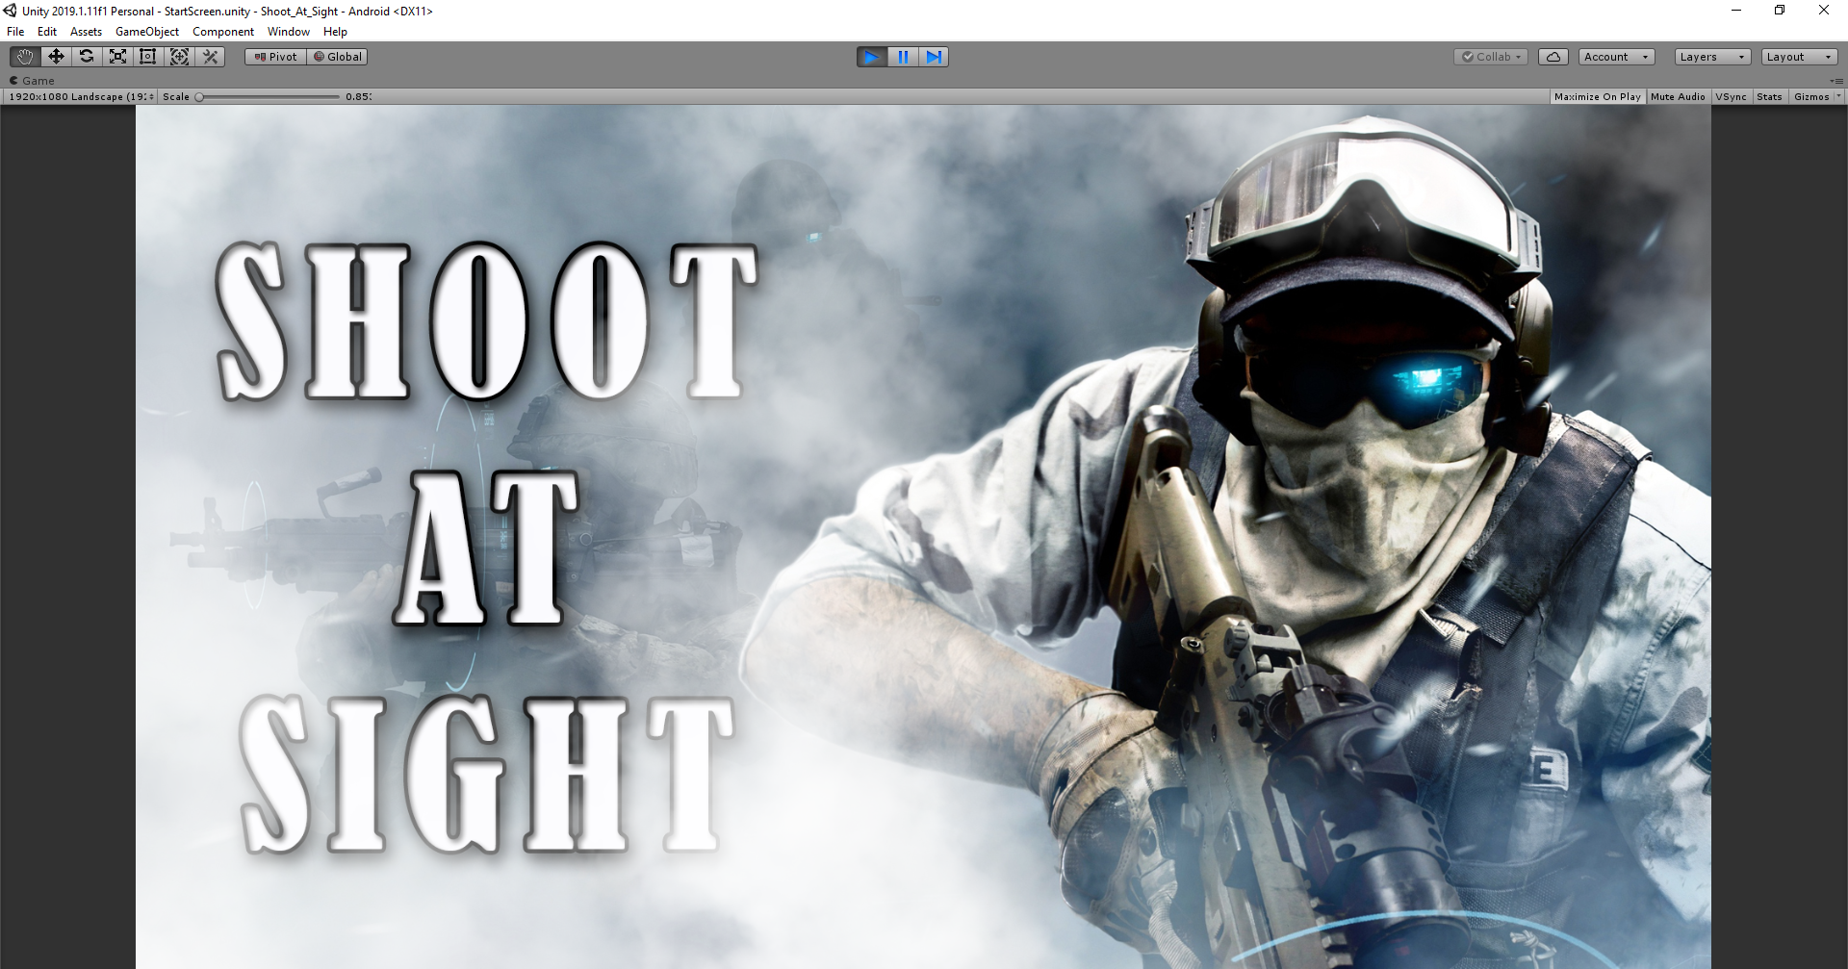
Work Update

Slide 19
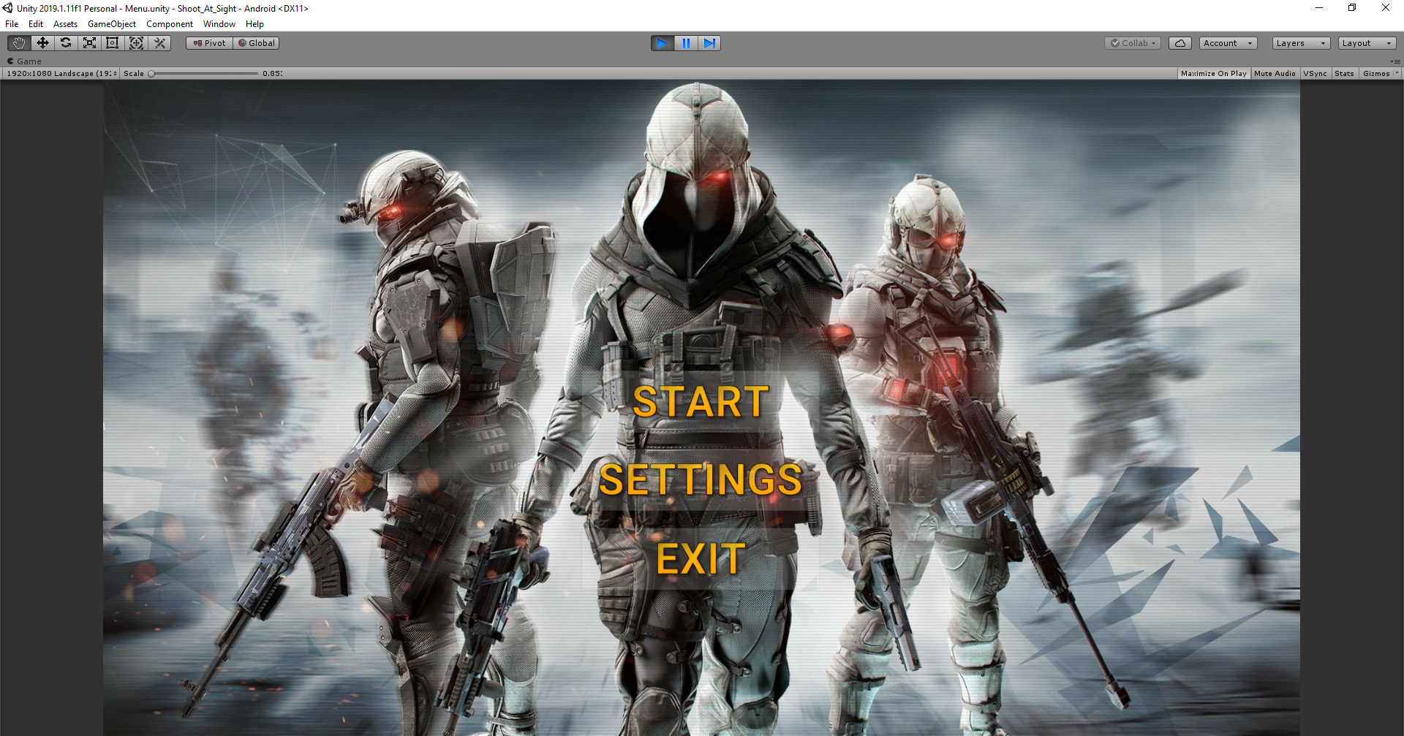
Cont..

Slide 20
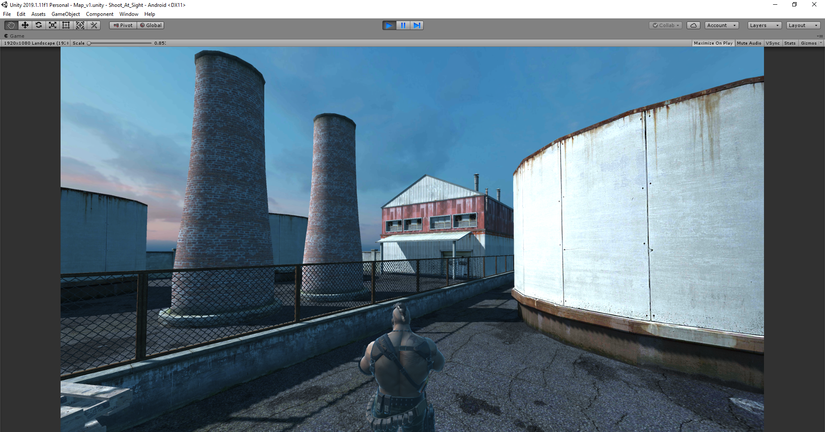
Cont..

Slide 21
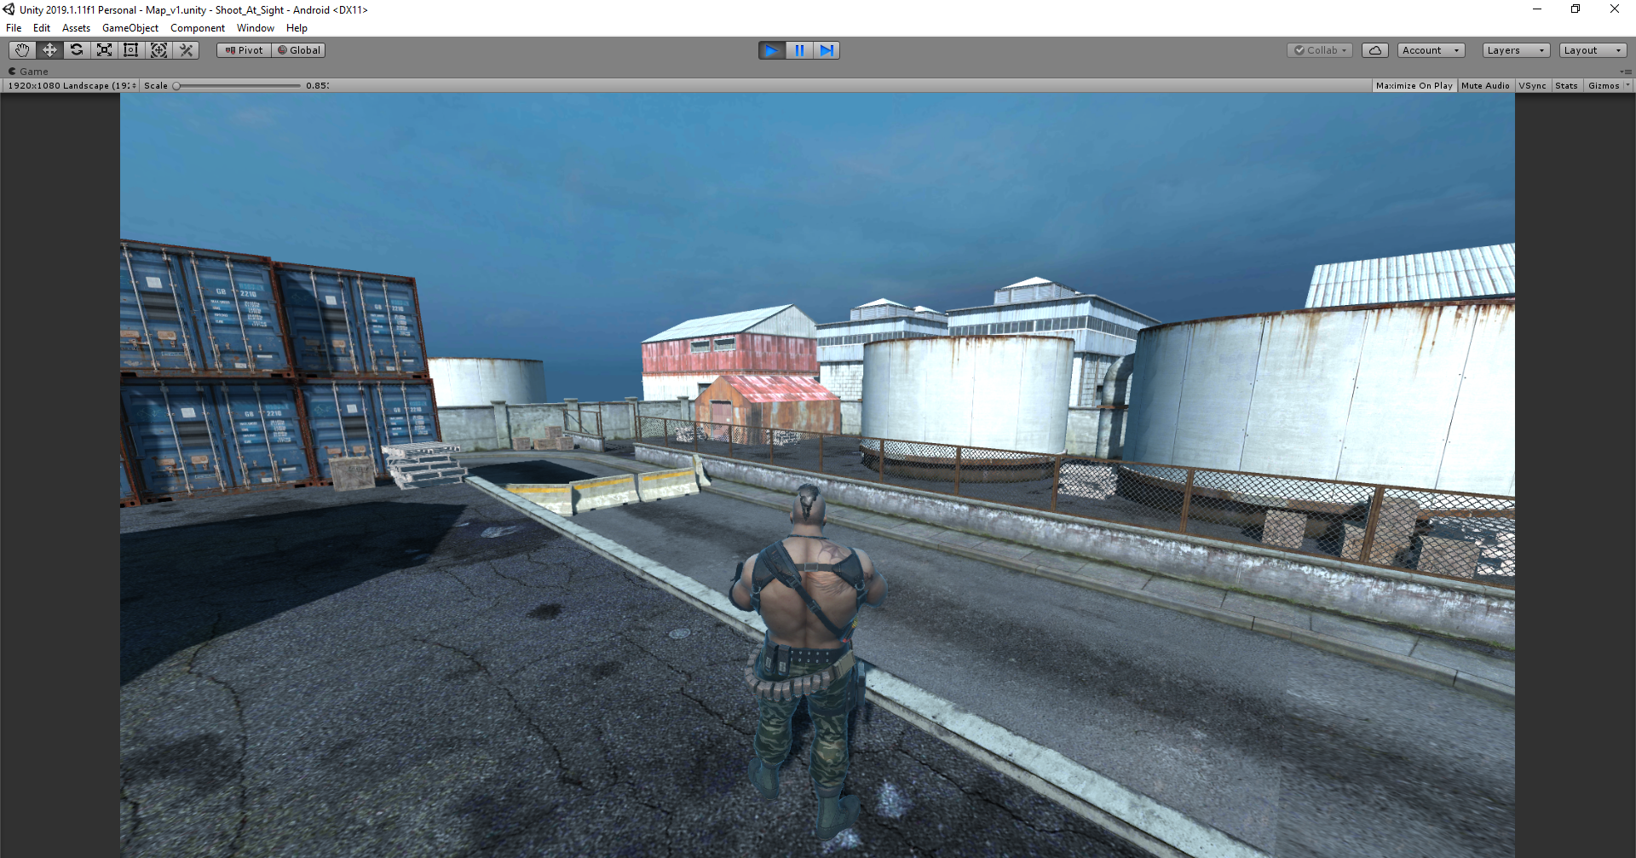
Cont..

